Slide 1
ROYAL CHALLENGERS BANGALORE - IPL STRATEGY
B N PRITHVIRAJ
DS JULY 2024 BATCH

Slide 2
PROBLEM STATEMENT
You are hired as a sports data analyst by RCB where the team is looking for top-performing and reliable players to win tournaments, considering both on-field performance and value for money in mega player auction of 2017.
Your task is to come up with strategies/suggestions regarding selecting the best-performing players and optimizing player auction investments.

Slide 3
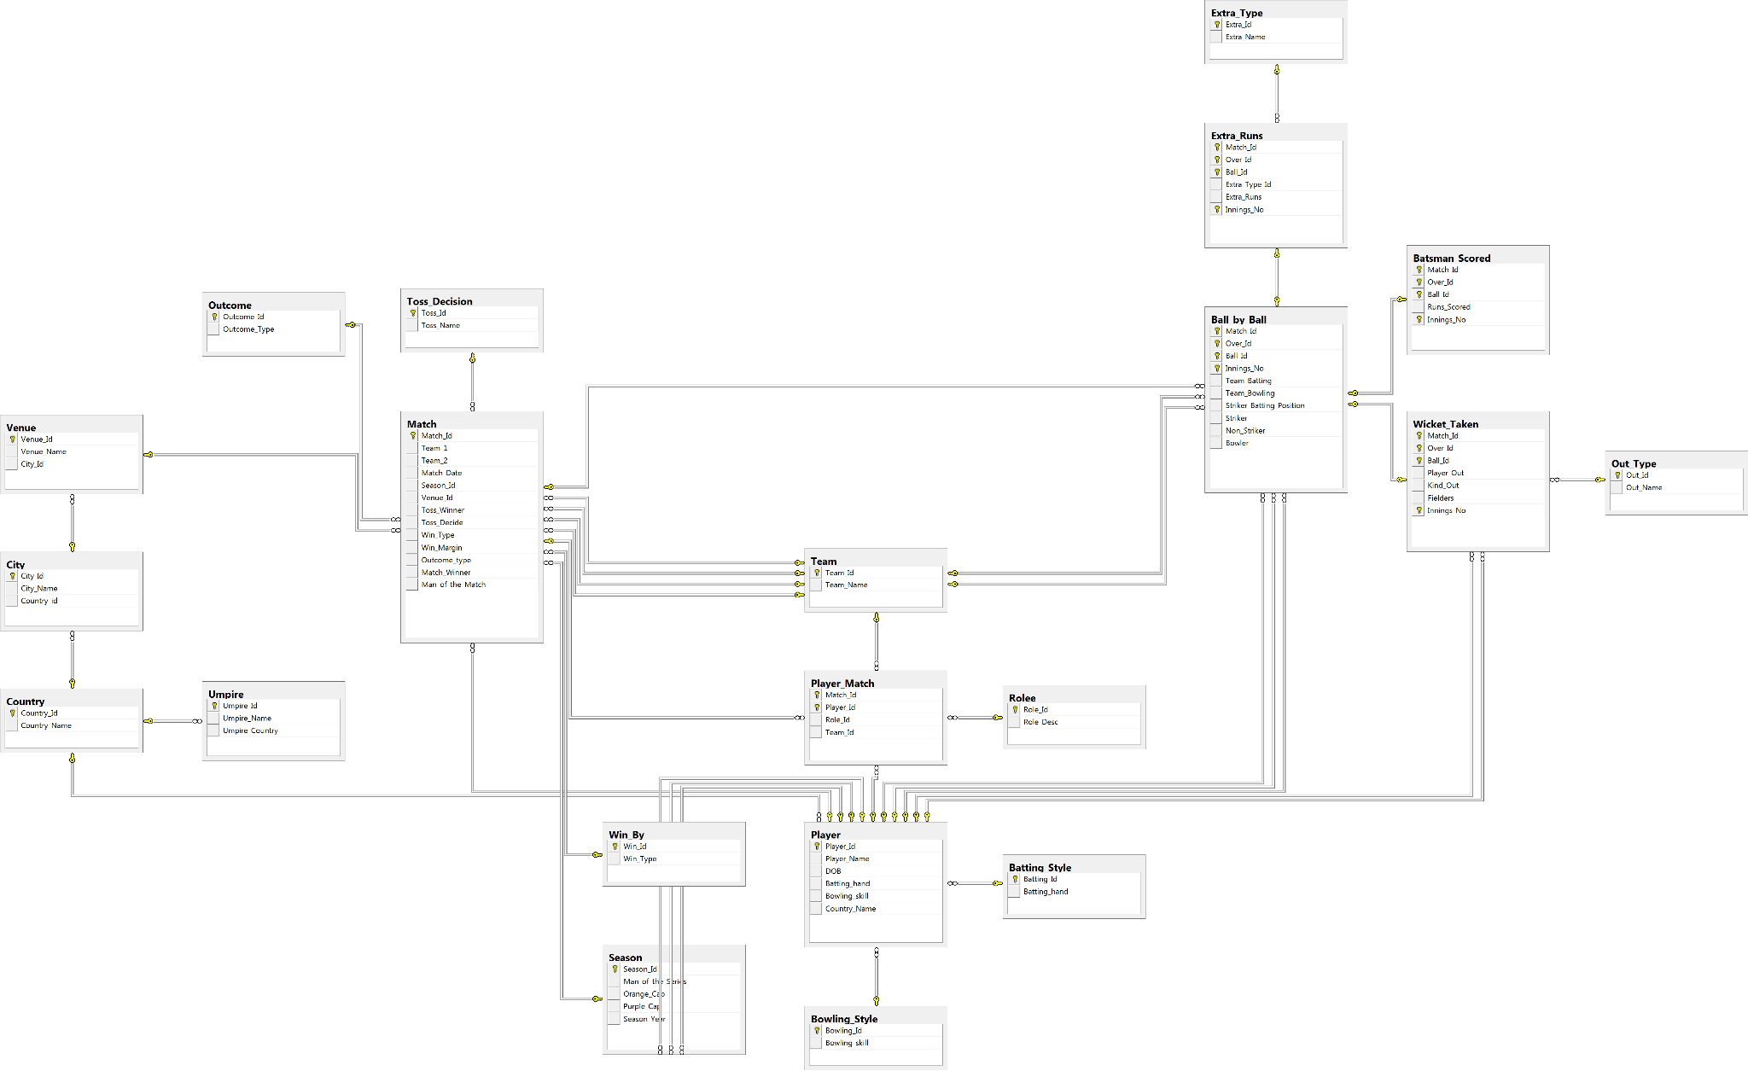
DATABASE SCHEMA

Slide 4
DATABASE SCHEMA OVERVIEW
Ball by Ball
Batting Style
Bowling Style
City
Extra Type
Season
Win By
Outcome
Out Type
Role
Team
Umpire
Toss Decision
Player

Slide 5
PLAYERS WITH HIGH STRIKE RATE
Top 10 Performers: Ranked by strike rate over the last four seasons for consistency.
Strike Rate: Calculated as total runs divided by balls faced, multiplied by 100.
250-Ball Benchmark: Ensures only players with sufficient appearances are included.
Strategic Insights: Identifies high-strike-rate players (e.g., AD Russell, AB de Villiers, MS Dhoni) for team strategy.

Slide 6
BEST BATTING AVERAGE
Objective: Calculate average runs per innings for each batsman across IPL seasons.
Data Sources: Player, ball_by_ball, and batsman_scored tables for performance metrics.
Calculation Method: Total runs divided by innings played to find average runs.
Top Performers: Rank players by highest average, featuring LMP Simmons and SE Marsh.

Slide 7
BEST BOWLING AVERAGE
Objective: Calculate average wickets per match for each bowler across IPL seasons.
Data Sources: Player, ball_by_ball, and wicket_taken tables for bowling stats.
Calculation Method: Total wickets divided by distinct matches played for average wickets.
Top Performers: Rank bowlers by average wickets, featuring DAJ Bracewell and YA Abdulla.

Slide 8
HOME GROUND PERFORMANCE
RCB Venue Performance: Summarizes wins, losses, and no-result matches across venues.
Data Source: Matches, team, and venue tables for match results.
No Result (NR) Calculation: NR determined by subtracting wins and losses from total matches.
Strategic Insight: Helps assess RCB’s performance consistency for better match preparation.

Slide 9
BOWLING STYLE ANALYSIS
Objective: Analyze the impact of bowling styles on total wickets taken.
Data Sources: Player, bowling_style, ball_by_ball, and wicket_taken tables for performance data.
Results: Right-arm medium bowlers lead in wickets, followed by right-arm fast-medium and medium-fast.
Strategic Insight: Identifies effective bowling styles for team selection and strategy.

Slide 10
COMPARISION WITH PREVIOUS SEASON
Objective: Analyze year-on-year IPL team performance based on runs and wickets.
Data Sources: Team, player_match, matches, batsman_scored, wicket_taken, and season tables.
Methodology: Calculated total runs and wickets per season using CTE, compared performance year-over-year.
Results for RCB: 3 seasons marked "Better," 2 as "Worse," and 3 as "Mixed," showing fluctuating performance.

Slide 11
RCB BOWLER’S ECONOMY
Powerplay Economy: RCB concedes 13.72 runs per over (overs 1–6), showing early-game effectiveness.
Middle Overs Economy: Allows 14.58 runs per over (overs 7–15), reflecting containment strategy.
Death Overs Economy: Concedes 17.33 runs per over (overs 16–20), highlighting late-innings challenges.
Phase-Wise Insights: Focus on improving economy rates in later overs for better overall performance.

Slide 12
PLAYERS PERFORMED IN M CHINNASWAMY STADIUM
Top Scorers: RS Bopara (149) and TL Suman (147) lead in average runs per match.
Consistent Performers: VVS Laxman (118), UBT Chand (114), and LMP Simmons (109) consistently score over 100.
Standout All-Rounders: AB de Villiers (55.07) and MS Dhoni (65.86) contribute valuable runs.
Power Hitters: Chris Gayle (65.29), Faf du Plessis (76), and David Warner (91.83) make explosive impacts.

Slide 13
TOSS IMPACT IN DIFFERENT VENUES
High Toss Impact: Dr. DY Patil Sports Academy and Subrata Roy Sahara Stadium show a 60% win rate for toss-winning teams.
Balanced Venues: Eden Gardens (56.05%) and M. Chinnaswamy (54%) show moderate toss impact.
Challenging Grounds: Rajiv Gandhi International Stadium has a 33.69% win rate, suggesting minimal toss impact.
Venue-Specific Strategy: Emphasize tailored strategies at venues with varying toss impacts for better performance.

Slide 14
SUITABLE PLAYERS FOR THE TEAM
Run Scoring Powerhouses: Virat Kohli and Chris Gayle lead with consistent high scores for RCB.
All-Rounders: Shane Watson (4281 runs, 251 wickets) and Jacques Kallis (2613 runs, 185 wickets) contribute significantly in all aspects.
Experienced Captains: MS Dhoni and Rohit Sharma bring strong leadership and match-winning experience.
Middle-Order Stalwarts: AB de Villiers (4517 runs) and Kieron Pollard (3704 runs, 241 wickets) provide stability in the middle order.

Slide 15
BEST BATTERS ACROSS TEAMS
High-Scoring Batsmen: Virat Kohli and Suresh Raina lead with consistent run accumulation and strong averages.
Efficient Strikers: AB de Villiers (136.97) and Chris Gayle (135.18) excel in quick scoring.
All-Round Capabilities: Gayle (88 wickets) and Rohit Sharma (54 wickets) provide value with both bat and ball.
Reliable Finishers: MS Dhoni (132.93 strike rate) shines as a dependable finisher.

Slide 16
VERSATILE PLAYERS
Top All-Rounders: Azhar Mahmood (33.3 avg) and JP Faulkner (18.15 avg) excel in both batting and bowling.
Consistent Performers: DJ Bravo (2364 runs, 449 wickets) and AR Patel (752 runs, 208 wickets) are key contributors.
Dual Threats: Andre Russell and Shakib Al Hasan add value with both bat and ball (137 and 158 wickets).
Veteran All-Rounders: Kieron Pollard, Shane Watson, Ravindra Jadeja, and Jacques Kallis offer experience and versatility.

Slide 17
KEY PLAYERS
100% Win Rate: P Amarnath (CSK) has a perfect win record, significantly boosting team performance.
High Impact Players: Sohail Tanvir (RR) has a 90.91% win rate across 11 matches, closely tied to team success.
Reliable Boosters: SB Jakati (GL) and Kamran Akmal (RR) both have over 83% win rates, influencing victories.
Top Contributors: MG Johnson (MI) and WP Saha (CSK) maintain strong win rates (76.47% and 76.92%).

Slide 18
TEAMS PERFORMANCE IN CHINNASWAMY STADIUM
Mumbai Indians Lead: Highest win rate of 75% across 8 matches, showing effective strategies at Chinnaswamy.
Chennai Super Kings: 57.1% win rate in 7 matches, adapting well to venue conditions.
Mixed Performance for RCB: 51.8% win rate in 56 matches, reflecting challenges and opportunities at home.
Lower Success Rates: Kings XI Punjab, Delhi Daredevils, and Sunrisers Hyderabad all have win rates below 50%, with Hyderabad at 40%.

Slide 19
RCB’S SEASON WISE PERFORMANCE
Inconsistent Performance: RCB’s win percentage fluctuates across seasons, reflecting challenges in consistency.
Best Season in 2011: Peak season with 62.5% win rate, showcasing strong team dynamics.
Moderate Success: 56.25% win rate in 2009, 2013, and 2016, indicating stability without a title.
Challenging Seasons: 2008 and 2014 saw tough performances with win rates of 28.6% and 35.7%.

Slide 20
RCB’S PERFORMANCE IN DIFFERENT VENUES
Home Performance: 51.8% win rate at M. Chinnaswamy Stadium.
Overseas Success: 75% win rate at Kingsmead and New Wanderers Stadium.
Challenging Venues: Low success at MA Chidambaram (25%) and Rajiv Gandhi Stadium (28.6%).
Isolated Wins: 100% win record at Brabourne, Nehru, and Subrata Roy Sahara.
Away Performance: 42.9% win rate at Wankhede and Eden Gardens.

Slide 21
PLAYER PERFORMANCES FOR RCB
Top Performer: Virat Kohli, RCB's highest run-scorer over 9 seasons.
Power Hitters: Chris Gayle (5,121 runs) and AB de Villiers (4,517 runs) as key power hitters.
All-Round Contributions: Jacques Kallis and R Vinay Kumar provided both runs and wickets.
Seasoned Consistency: Rahul Dravid, Manish Pandey, and Mayank Agarwal contributed consistently over 2–3 seasons.
Single-Season Impact: Yuvraj Singh made a notable impact in a single season.

Slide 22
HOME vs AWAY VENUE PERFORMANCE
Balanced Performance: RCB has a 51.8%-win rate at home and 49.4% away, showing minimal home-ground advantage.
Home Advantage Limited: RCB's win rate at M. Chinnaswamy Stadium reflects room for improvement.
Challenging Away Games: RCB's win rate across 83 away/neutral games highlights the need to strengthen away strategies.
Higher Match Count Away: A higher number of away matches suggests the need for consistent performance in diverse conditions.
Opportunities for Improvement: Focusing on away and neutral venue strategies can enhance title contention.

Slide 23
DEFENDING vs CHASING PERFORMANCES
Better Success in Defending: RCB has a 52.6% win rate when defending a total, performing slightly better under pressure.
Challenges in Chasing: With a 47.5% win rate while chasing, RCB struggles with consistency in this aspect.
Significant Defending: RCB has defended a score in 78 matches, contributing to their better success rate.
Inconsistencies in Chase: Despite strong power hitters, RCB’s chasing struggles indicate room for improvement.
Opportunity to Improve Chasing: Strengthening chasing strategies could enhance RCB's competitiveness and match-winning potential.

Slide 24
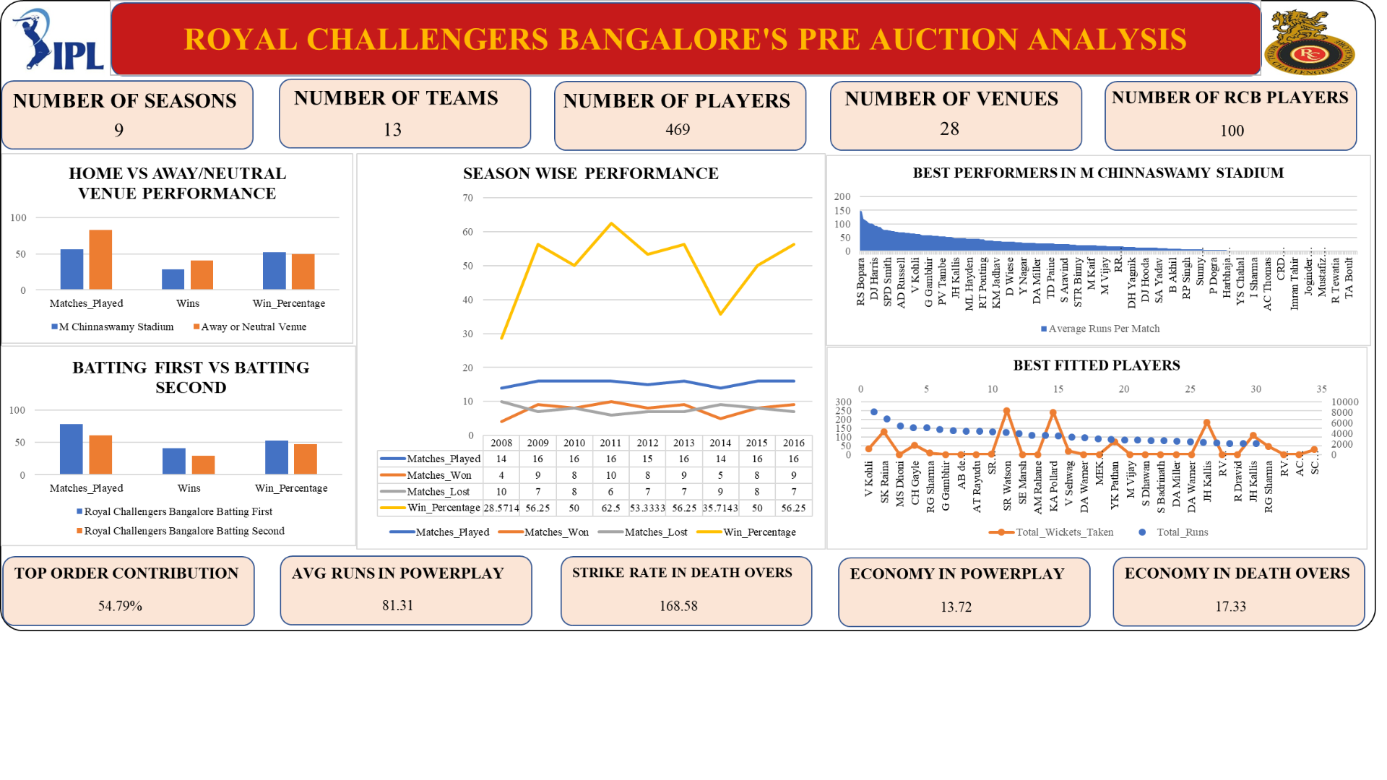
PERFORMANCE DASHBOARD

Slide 25
THANK YOU

